Slide 1
IoT Data Management and Compute Stack
The data generated by IoT sensors is one of the single biggest challenges in building an IoT system
In most cases, the processing location is outside the smart object.
A natural location for this processing activity is the cloud.
Smart objects need to connect to the cloud, and data processing is centralized.
One advantage of this model is simplicity.
Objects just need to connect to a central cloud application.
As data volume, the variety of objects connecting to the network, and the need for more efficiency increase, new requirements appear like Minimizing latency, Conserving network bandwidth, Increasing local efficiency.
An important design consideration, therefore, is how to design an IoT network to manage this volume of data in an efficient way such that the data can be quickly analyzed and lead to business benefits.

Slide 2
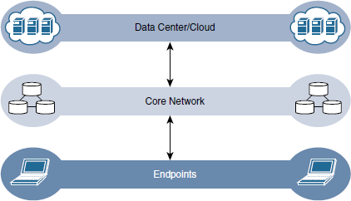
Traditional IT Cloud Computing Model
Data management in traditional IT systems is very simple.
The endpoints communicate over an IP core network to servers in the data center or cloud.
Data is generally stored in the data center, and the physical links from access to core are typically high bandwidth, meaning access to data is quick.

Slide 3
Data-Related Problems in IoT Systems
Bandwidth in last-mile IoT networks is very limited. When dealing with thousands/ millions of devices, available bandwidth may be on order of tens of Kbps per device
Latency can be very high. Instead of dealing with latency in the milisec range, large
IoT networks often introduce latency of hundreds to thousands of milisec
Network backhaul from the gateway can be unreliable and often depends on 3G/LTE or even satellite links which may be expensive
The volume of data transmitted over the backhaul can be high, and much of the
data may not really be that interesting
The concept of storing and analyzing all sensor data in the cloud is impractical
The sheer volume of data generated makes real-time analysis and response to the data almost impossible

Slide 4
IoT Data Management and Compute Stack with Fog Computing
The solution to these challenges is to distribute data management throughout the IoT system, as close to the edge of the IP network as possible.
The best-known embodiment of edge services in IoT is fog computing.
Any device with computing, storage, and network connectivity can be a fog node.
Examples include industrial controllers, switches, routers, embedded servers, and IoT gateways.
Analyzing IoT data close to where it is collected minimizes latency, offloads gigabytes of network traffic from the core network, and keeps sensitive data inside the local network.
An advantage of this structure is that the fog node allows intelligence gathering (such as analytics) and control from the closest possible point, and in doing so, it allows better performance over constrained networks.
In one sense, this introduces a new layer to the traditional IT computing model, one that is often referred to as the fog layer.

Slide 5
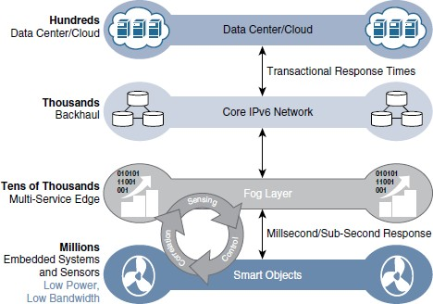
The IoT Data Management and Compute Stack with Fog Computing

Slide 6
Characteristic of fog computing
Contextual location awareness and low latency: The fog node sits as close to the IoT endpoint as possible to deliver distributed computing.
Geographic distribution: In sharp contrast to the more centralized cloud, the services and
applications targeted by the fog nodes demand widely distributed deployments.
Deployment near IoT endpoints: Fog nodes are typically deployed in the presence of a large number of IoT endpoints. For example, typical metering deployments often see 3000 to 4000 nodes per gateway router, which also functions as the fog computing node.
Wireless communication between the fog and the IoT endpoint: Although it is possible to connect wired nodes, the advantages of fog are greatest when dealing with a large number of endpoints, and wireless access is the easiest way to achieve such scale.
Use for real-time interactions: Important fog applications involve real-time interactions rather than batch processing. Preprocessing of data in the fog nodes allows upper-layer applications to perform batch processing on a subset of the data.

Slide 7
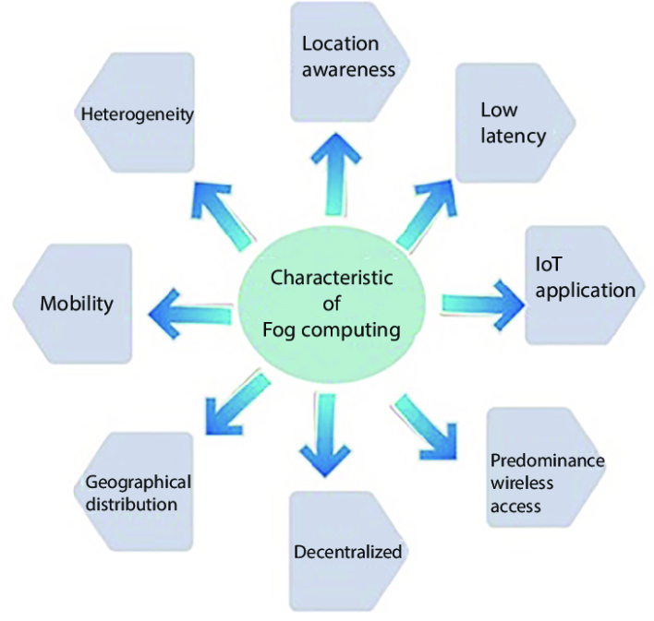

Slide 8
Applicability of Edge Computing
The natural place for a fog node is in the network device that sits closest to the IoT endpoints, and these nodes are typically spread throughout an IoT network.
However in recent years, the concept of IoT computing has been pushed even further to
the edge, and in some cases it now resides directly in the sensors and IoT devices
Edge computing is also sometimes called mist computing. If clouds exist in the sky, and fog sits near the ground, then mist is what actually sits on the ground
Thus, the concept of mist is to extend fog to the furthest point possible, right into the IoT endpoint device itself
Some new classes of IoT endpoints have enough compute capabilities to perform at least
low-level analytics and filtering to make basic decisions (eg. Raspberry Pi, Arduino)
Example: Edge compute–capable meters are able to communicate with each other to share information on small subsets of the electrical distribution grid to monitor localized power quality and consumption, and they can inform a fog node of events that may pertain to only tiny sections of the grid
These models can help to ensure the highest quality of power delivery to customers

Slide 9
Hierarchy of Edge, Fog, and Cloud
Edge or fog computing in no way replaces the cloud. Rather, they complement each other, and many use cases actually require strong cooperation between layers
Edge and fog computing layers simply act as a first line of defense for filtering, analyzing, and otherwise managing data endpoints. This saves the cloud from being queried by each and every node for each event
This model suggests a hierarchical organization of network, compute, and data storage resources
At each stage, data is collected, analyzed, and responded to when necessary according to the capabilities of the resources at each layer
As data needs to be sent to the cloud, the latency becomes higher
The advantage of this hierarchy is that a response to events from resources close to the end device is fast and can result in immediate benefits, while still having deeper compute resources available in the cloud when necessary

Slide 10
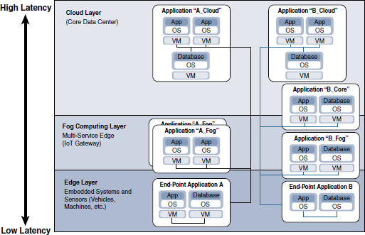
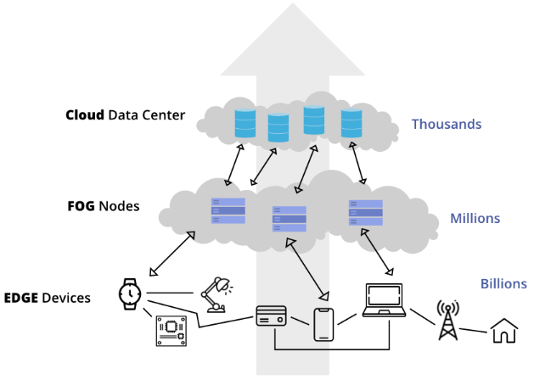
Hierarchy of Edge, Fog, and Cloud

Slide 11
Edge, Fog, and Cloud
Fog Computing Architecture
Fog computing architecture consists of three layers: the edge layer, the fog layer, and the cloud layer. The edge layer is where the data is generated and collected, while the fog layer is where the data is processed and analyzed. The cloud layer provides additional computing resources and storage capacity for the fog layer.
Types of Fog Computing
There are several types of fog computing, including client-based, server-based, and hybrid fog computing.
Client-Based Fog. This type of fog computing relies on the computing power of edge devices to process and analyze data. Client-based fog computing is ideal for applications that require real-time processing, such as autonomous vehicles and industrial IoT.
Server-Based Fog. This type of fog computing relies on the computing power of servers located in the fog layer to process and analyze data. Server-based fog computing is ideal for applications that require more computing power than edge devices can provide.
Hybrid Fog. This type of fog computing combines both client-based and server-based fog computing. Hybrid fog computing is ideal for applications that require a mix of real-time processing and high computing power.

Slide 12
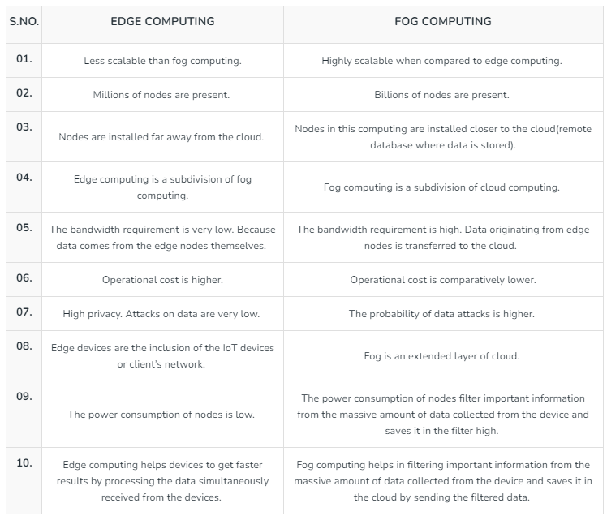
Edge Computing vs Fog Computing

